Slide 1

YouTube Songs Analysis
Presented by Jatin Kashyap under Batch No MIP-DA-10

Slide 2
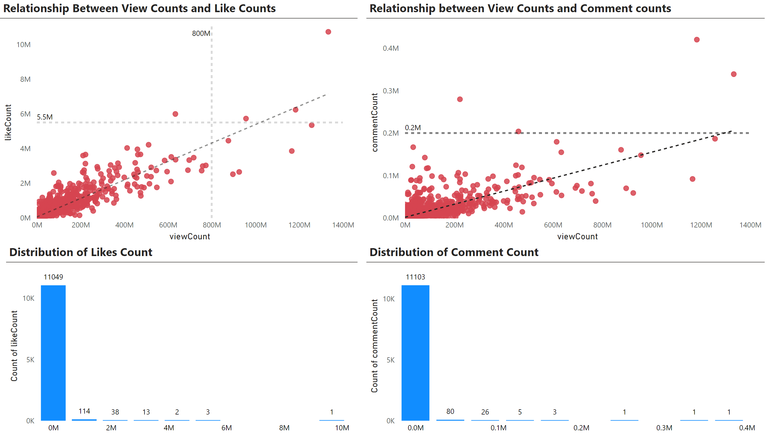

Slide 3
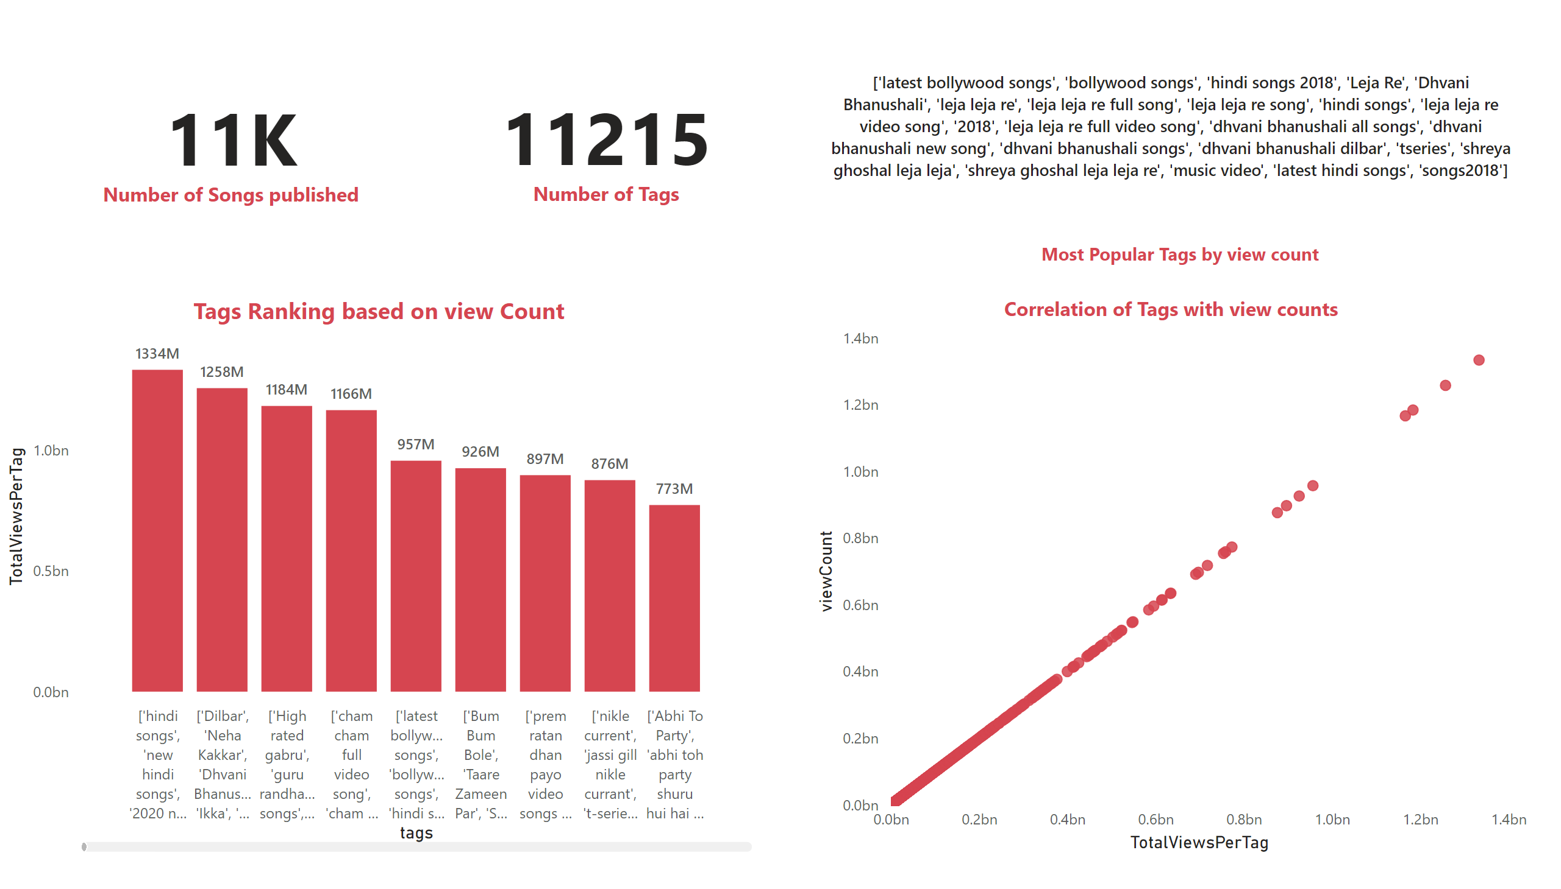

Slide 4
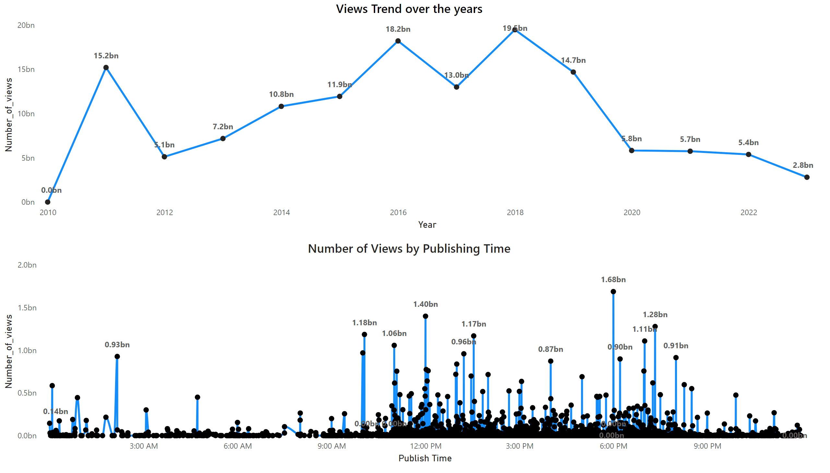

Slide 5
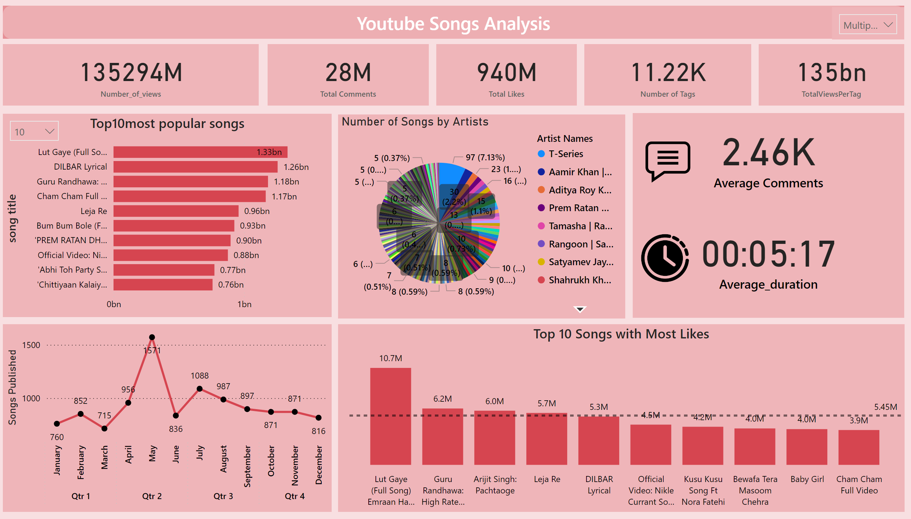

Slide 6
Key Insights
‘Lut Gaye’ title song lead by Artists Emraan Hashmi and Yukti is the overall most viewed song with views of 1.33 Billion. It stands out as high with likes of 10.7 Million, suggesting it is both widely watched and highly appreciated.
T-Series is the leading music label, with a significant count of overall 97 songs attributed to it. This indicates its strong presence and influence in the music industry. Artists and albums like "Swanand Kirkire" (7 songs), "All Is Well" (6 songs), "Bhaag Johnny" (6 songs), and "Ishq Ne Krazy kiya Re" (6 songs) are notable for their multiple contributions.
With 1334 Million, ['hindi songs', 'new hindi songs', '2020 new songs', 't-series', 'tseries', 'tseries songs', 'hit songs 2020', '2020 film songs', 'bollywood songs', '2020 songs', 'hindi 2020 songs', 'hindi movie songs', 'lut gaye', 'lut gaye emraan hashmi', 'lut gaye jubin nautiyal', 'Tanishk Bagchi', 'manoj muntashir', 'manoj muntashir songs', 'tanishk bagchi songs', 'emraan hashmi songs', 'lut gaye new song', 'emraan hashmi new song', 'tanishk bagchi new song 2021', 'jubin nautiyal', 'jubin nautiyal song', 'jubin nautiyal new songs'] had the highest TotalViewsPerTag

Slide 7
Key Insights
May stands out as the month of the highest songs published, with a total of 1571 Songs. March has the lowest number of Songs Published. Qtr. 2 (April to June) has the highest number of songs published (3363 songs),suggesting a peak period for song releases
The most effective times for publishing content, based on viewership peaks, seem to be around 2:00 AM, 12:00 PM, 6:00 PM, and 7:00 PM. Engagement appears to increase steadily from early afternoon through the evening, with several peaks between 3:00 PM and 9:00 PM, indicating higher viewer engagement during these times.
There is a clear positive correlation between view counts and like counts, as indicated by the upward trend in the scatter plot and the dotted trend line. This means that as the number of views increases, the number of likes generally also increases. There are a few outliers with very high view counts (800M to 1400M views) and corresponding high like counts (6M to 10M likes). These outliers represent highly popular content that has garnered significant engagement.

